Slide 1
University of Kentucky Libraries
Snapshot Guide
to Library Services
Notes:
1

Slide 2
We Are a Library System
The University of Kentucky Libraries --
* A network of 15 Libraries and Information Centers
* Individual libraries are subject oriented
* Library staff have subject expertise
Notes:
4

Slide 3
Libraries & Information Centers
William T. Young
Library
King
Library
Education
Library
Special Collections
and Archives
Agriculture
Information Center
Medical Center
Library
Law
Library
Science &
Engineering Libraries
Fine Arts
Libraries
Lexington Community College

Slide 4
Information about the Library System
Over 2.8 million volumes
Over 13,000 e-journals (and growing!)
Over 10,000 e-books (and growing!)
30,000 periodical subscriptions
6 million microforms
Notes:
12

Slide 5
More Information about the Library System
Regional depository of government information
1.1 million government documents
Non-print collection
computer & music CDs, slides, videos
28th largest public university library
Notes:
13

Slide 6
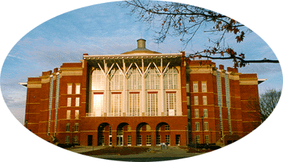
William T. Young Library
Social Sciences
Humanities
Life Sciences
General Library Services
Notes:
8

Slide 7
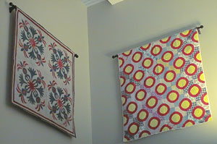
William T. Young Library
Opened April 1998
182 seat computer lab
Computer equipped classrooms
Audio Visual Services / Laptop Loan
Distance Learning support
Group study & meeting rooms
Notes:
9

Slide 8
Other Libraries
Fine Arts Libraries
Science & Engineering
Libraries
Education Library
John A. Morris Library

Slide 9
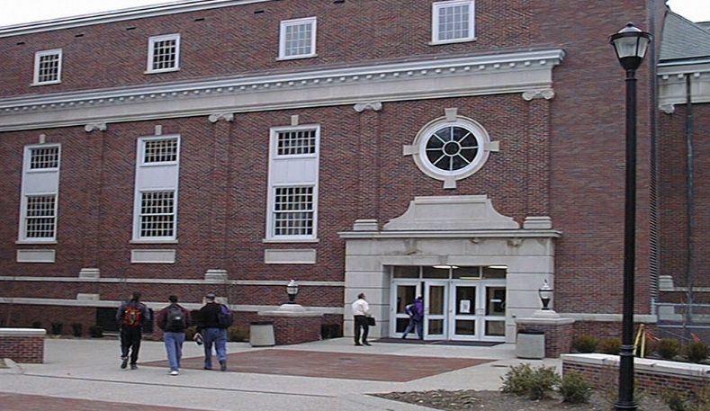
More Libraries
M. I. King Library
Maps Collection Temporary Storage Collection
Future location of consolidated Science/Engineering Libraries
```````````````````````````````````````````````````````````````

Slide 10
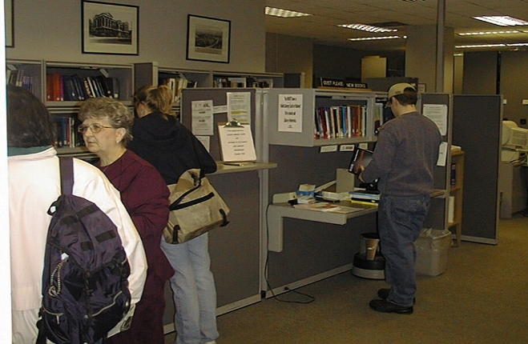
Science and Engineering
Chemistry / Physics Library
KY Transportation Center Library
Math Sciences Library
Engineering Library
Geology Library
Notes:
6

Slide 11
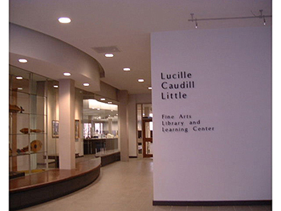
Fine Arts
Fine Arts Library
Art
Music
Theater
Architecture Library
Notes:
7

Slide 12
Services at All Libraries
Libraries’ online catalog
Access to electronic products
Internet access
Renew and return books
Ask questions
Get help!
Notes:
11

Slide 13
Libraries Home Page http://www.uky.edu/Libraries/

Slide 14
Electronic Information http://www.uky.edu/Libraries/
Information about Libraries and services
Subject guides to electronic resources
Pointers to Internet resources
Online forms for feedback and requests
Interlibrary Loan
Book purchase requests
Reference questions
Notes:
17

Slide 15
Electronic Access to the World: http://www.uky.edu/Libraries/ …the starting point for all your needs!
Assistance in finding resources on the Internet
Access databases in all subject areas
Search library catalogs around the world
Notes:
14

Slide 16
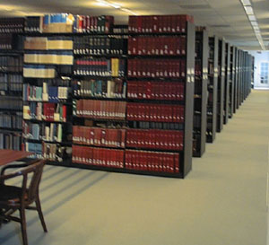
What Can a Librarian Do for You?
Help with planning your research
Teach you how to locate information
Teach you how to evaluate information
Save you time!
Notes:
2

Slide 17
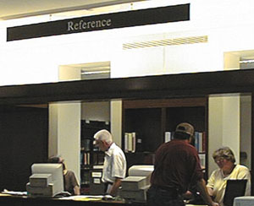
Best Strategy
Ask for help when you start your project
Reference assistance is available on the 2nd floor of W. T.
Young Library
& in every library!
Notes:
3

Slide 18
Library Partnerships
Participates in the KY Virtual Library
Partnership with all KY libraries
Partnerships with other research libraries
Access to materials from these libraries
Notes:
18

Slide 19
Training and Tours
UK101
English classes
Other classes
Individual assistance
Audio-tape self tours of
William T. Young Library
Notes:
19

Slide 20
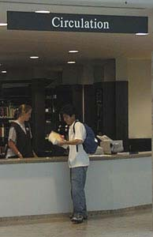
Work Opportunities
Federal Work Study opportunities
Student assistant positions available
Opportunity to learn as you work
Pleasant work environment
Flexible schedules
Apply at any library on
campus!
Notes:
20

Slide 21
What about…?
Disability Services – Are available from staff at the Young Reference Desk
Typewriters -- You can get one at the Young Circulation Desk
Individual Library’s Hours – Are posted on web sites
Course Reserves – Available electronically or in print; consult individual libraries
Food / Drink – Available in Ovid’s Café
Internet Connectivity – Is in all libraries!

Slide 22
See you in August when classes begin!!!
Come to the University of Kentucky Libraries for YOUR information needs!
Notes:
22

